Slide 1
Integer Programming Models
There are several frequently occurring circumstances in some business problems can be solved only if variables have integer values.
Example : Airline decides on the number of flights to operate in a given sector must be an integer or whole number amount.
Other examples:
The number of aircraft purchased this year
The number of machines needed for production
The number of trips made by a sales person
The number of police officers assigned to the night shift.

Slide 2
NEED FOR INTEGER PROGRAMMING METHODS
By rounding off a real value to an integer value have several
fundamental problems like :
1. Rounded solutions may not be feasible
2. Even if the solutions are feasible, the objective function given by the rounded off solutions may not be the optimal one
3. Finally, even if the above two conditions are satisfied, checking all the rounded-off solutions is computationally expensive
(2^{n} possible solutions to be considered for an n variable problem)
This demands the need for Integer Programming

Slide 3
Example :
The Harrison Electric Company produces two products: old-fashioned chandeliers and ceiling fans. Both products require a two-step process involving wiring and assembly. It takes 2 hours to wire each chandelier and 3 hours to wire a ceiling fan. Final assembly of the chandeliers and fans requires 6 and 5 hours, respectively. The production capability is such that only 12 hours of wiring time and 30 hours of assembly time are available. If each chandelier produced nets the firm Rs.7.00 and each fan Rs.6.00, the Production mix decision can be formulated using LP as follows:
Maximize profit = 7.00 X1 + 6.00 X2
subject to:
2X1 + 3X2 =< 12 ( wiring hours )
6X1 + 5X2 =< 30 ( assembly hours )
X1, X2 => 0
where:
X1 = number of chandeliers produced
X2 = number of ceiling fans produced
The optimal solution is X1 = 3.75 chandeliers and X2 = 1.5 ceiling fans.
Rounding to X1 = 4 and X2 = 2 makes the solution unfeasible.

Slide 4
There are 18 feasible integer solutions to this problem.
Chandeliers ( X1 ) Ceiling Fans ( X2 ) Profit ( Z )
0 0 0.00
1 0 7
2 0 14
Listing all feasible solutions and selecting the one with the best objective function value is called the enumeration method.
3 0 21
4 0 28
5 0 35
0 1 6
1 1 13
2 1 20
The optimal integer solution is X1 = 5 and X2 = 0 , with a total
profit of 35.00
3 1 27
4 1 34
0 2 12
1 2 19
2 2 26
3 2 33
0 3 18
1 3 25
0 4 24
This can be virtually impossible for large problems where the number of feasible solutions is extremely large!

Slide 5
AREAS OF APPLICATIONS OF INTEGER PROGRAMMING
An Integer LP Problem has some more important applications.
All Assignment and Transportation Problems
Capital budgeting,
Construction scheduling,
Production Scheduling
Plant location and size,
Routing and shipping schedule,
Capacity expansion,
Fixed charge, etc.,
are few problems that demonstrate the areas of applications of integer programming.

Slide 6
Mathematical Model of Integer Linear Programming(ILP)
The mathematical model for Pure (Mixed) Integer Programming (IP) or more precisely Integer Linear Programming (ILP) is the LP model with one additional restriction/constraint: “All (Some) variables must have integer values”.
Standard form of an ILP:
X must be integer valued
Associated linear program, dropping the integer restrictions, is called Regular Linear Programming Problem (LPP)

Slide 7
Remarks for ILP
Minimization: Optimal objective value for LPP is less than or equal to the optimal objective for ILP
Maximization: Optimal objective value for LPP is greater than or equal to that of ILP
If LPP is infeasible, then ILP is also infeasible
If LPP is optimized by integer variables, then that solution is feasible and optimal for ILP

Slide 8
Types of Integer Programming Problems
Pure integer programming problems.
All decision variables must have integer solutions.
Mixed integer programming problems.
Some, but not all, decision variables must have integer solutions.
Non-integer variables can have fractional optimal values.
Pure binary (or Zero - One) integer programming problems.
All decision variables are of special type known as binary.
Variables must have solution values of either 0 or 1.
Mixed binary integer programming problems.
Some decision variables are binary, and other decision variables are either general integer or continuous valued.

Slide 9
Methods for Solving Integer Programming Problems
1. Cutting Plane Method
2. Branch-and Bound(B&B)Method

Slide 10
Introduction of Cutting Plane Method (Gomory’s Cutting Plane method)
The first Method for solving ILP Problems was the Cutting Plane Method. It is developed by Ralph E. Gomory in the year 1958. In this method, Original feasible region is reduced to a new feasible region by including additional constraints such that all vertices of the new feasible region are now integer points. Thus, an extreme point of the new feasible region becomes an optimal solution after accounting for the integer constraints.

Slide 11
The general procedure for Gomory’s cutting plane method is as follows:
Step1: Ignore the integer restrictions and Solve the LPP using the simplex method.(Regular/Two Phase/Dual)
Step2: Check whether the Optimal Solution of LPP is integer.
If the Optimal solution is satisfied the integer restrictions, Stop.
Otherwise , GO to Next step.
Step3: Construct a “cut” derived from the Basic variable row (Source row) that has a non integer variable with the largest fractional value and add to the current Optimal Simplex tableau. If there is a tie select any row arbitrarily.

Slide 12
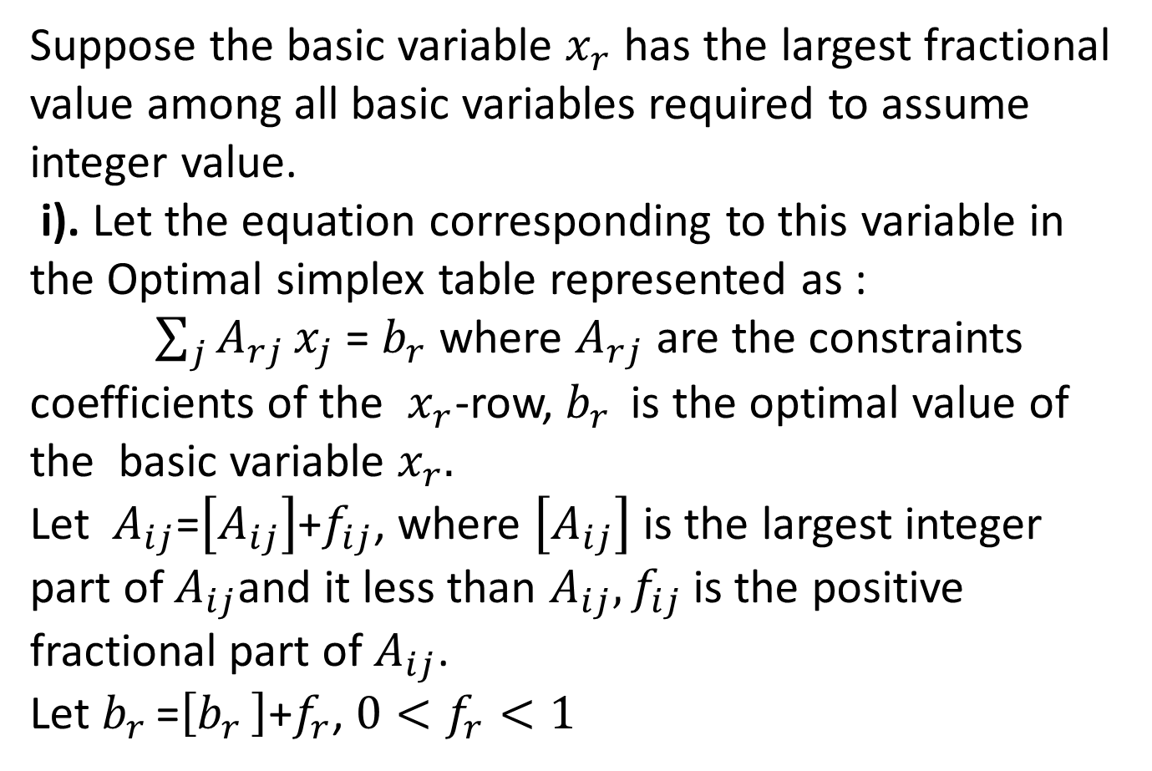
Suppose the basic variable $x_{r}$ has the largest fractional value among all basic variables required to assume integer value.
i). Let the equation corresponding to this variable in the Optimal simplex table represented as :
$\sum_{j}{A_{rj}}x_{j}$ = $b_{r}$ where $A_{rj}$ are the constraints coefficients of the $x_{r}$-row, $b_{r }$ is the optimal value of the basic variable $x_{r}.$
Let $A_{ij}$=$\left[A_{ij}\right]$+$f_{ij}$, where $\left[A_{ij}\right]$ is the largest integer part of $A_{ij}$and it less than $A_{ij}, f_{ij}$ is the positive fractional part of $A_{ij}$.
Let $b_{r }$=$\left[b_{r }\right]$+$f_{r}$, $0<f_{r}<1$

Slide 13
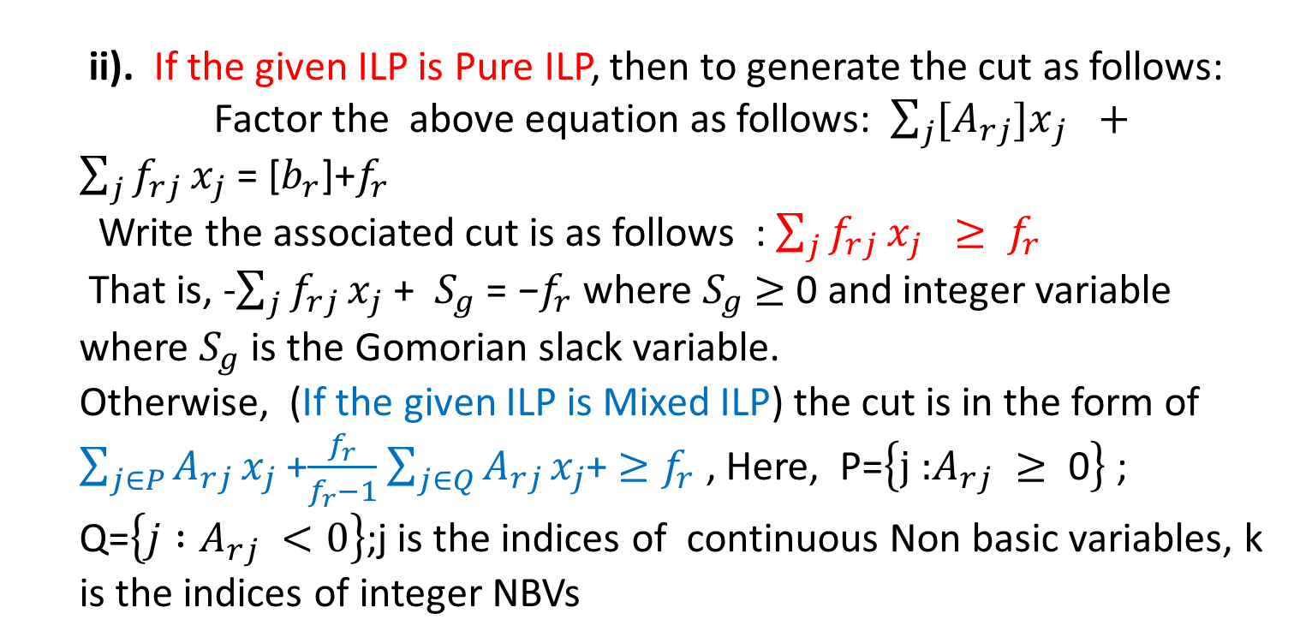
ii). If the given ILP is Pure ILP, then to generate the cut as follows:
Factor the above equation as follows: $\sum_{j}{{[A}_{rj}}{]x}_{j }+\sum_{j}{f_{rj}}x_{j}\text{ = [}b_{r}$]+$f_{r}$
Write the associated cut is as follows : $\sum_{j}{f_{rj}}x_{j} ≥ f_{r}$
That is, -$\sum_{j}{f_{rj}}x_{j}\text{ +}$ $S_{g}\text{ = }\text{−}f_{r}$ where $S_{g}$ $≥$ 0 and integer variable where $S_{g}$ is the Gomorian slack variable.
Otherwise, (If the given ILP is Mixed ILP) the cut is in the form of
$\sum_{j∈P}{A_{rj}}x_{j}$ +$\frac{f_{r}}{f_{r}−1}$ $\sum_{j∈Q}{A_{rj}}x_{j}$+ $≥f_{r}$ , Here, P=$\left\{\text{j}\text{ :}A_{rj} ≥\text{ 0}\right\}$ ; Q=$\left\{j :A_{rj} <0\right\}$;j is the indices of continuous Non basic variables, k is the indices of integer NBVs
That is ,
$−\sum_{j∈P}{A_{rj}}x_{j}$ - ($\frac{f_{r}}{f_{r}−1}$) $\sum_{j∈Q}{A_{rj}}x_{j}+S_{g}{=−f}_{r}$

Slide 14
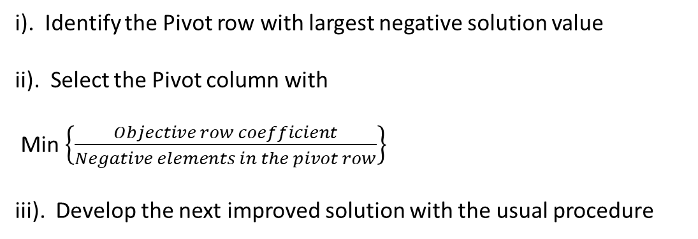
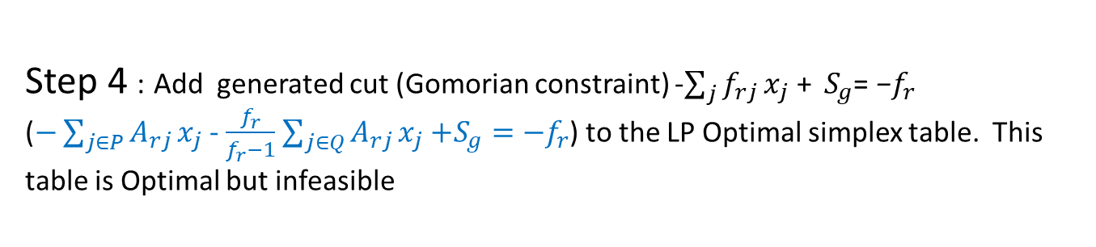
Step 4 : Add generated cut (Gomorian constraint) -$\sum_{j}{f_{rj}}x_{j}\text{ + }$ $S_{g}\text{= }\text{−}f_{r}$
($−\sum_{j∈P}{A_{rj}}x_{j}$ - $\frac{f_{r}}{f_{r}−1}$ $\sum_{j∈Q}{A_{rj}}x_{j}$ $+S_{g}{=−f}_{r}$) to the LP Optimal simplex table. This table is Optimal but infeasible
Step 5 : Apply Dual Simplex Method to recover the feasibility
i). Identify the Pivot row with largest negative solution value
ii). Select the Pivot column with
Min $\left\{\frac{Objective row coefficient}{Negative elements in the pivot row}\right\}$
iii). Develop the next improved solution with the usual procedure

Slide 15
Step 6 :
Check whether the new solution is satisfied the integer restrictions or not.
If not satisfied the integer restrictions, then a new Gomorian constraint is developed for the non-integer valued basic variable from the new optimal simplex tableau and the dual simplex method is applied again. The process is continued until either an optimal integer solution is obtained or It shows that the problem has no feasible integer solution.

Slide 16

Example 1 (Cutting Plane Method)
Consider the following all Integer Linear Programming Problem
Maximize Z= 6$x_{1}$+2$x_{2}$
subject to
3$x_{1}$+2$x_{2}≤5$
$x_{1}$, $x_{2}≥$ 0 and integers

Slide 17
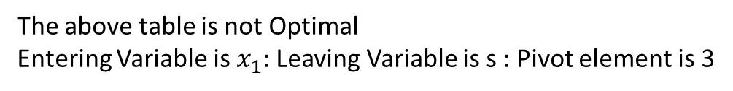
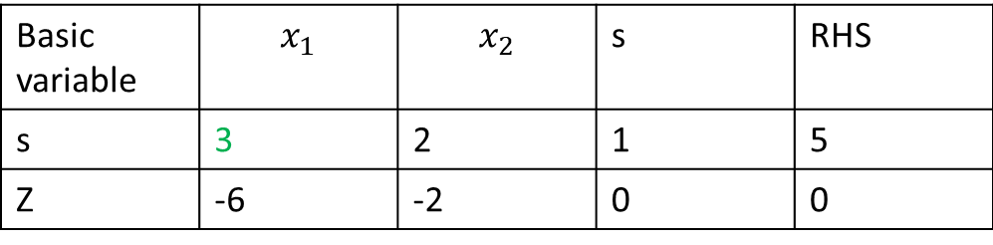
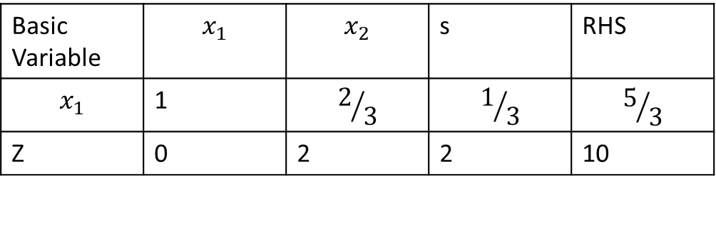

Step 1 : Solve the LPP
Basic variable | $$x_{1}$$ | $$x_{2}$$ | s | RHS
s | 3 | 2 | 1 | 5
Z | -6 | -2 | 0 | 0
Basic variable | $$x_{1}$$ | $$x_{2}$$ | s | RHS
s | 3 | 2 | 1 | 5
Z | -6 | -2 | 0 | 0
The above table is not Optimal
Entering Variable is $x_{1}$: Leaving Variable is s : Pivot element is 3
Basic Variable | $$x_{1}$$ | $$x_{2}$$ | s | RHS
$$x_{1}$$ | 1 | $$2/3$$ | $$1/3$$ | $$5/3$$
Z | 0 | 2 | 2 | 10
This is Optimal simplex table of LPP

Slide 18
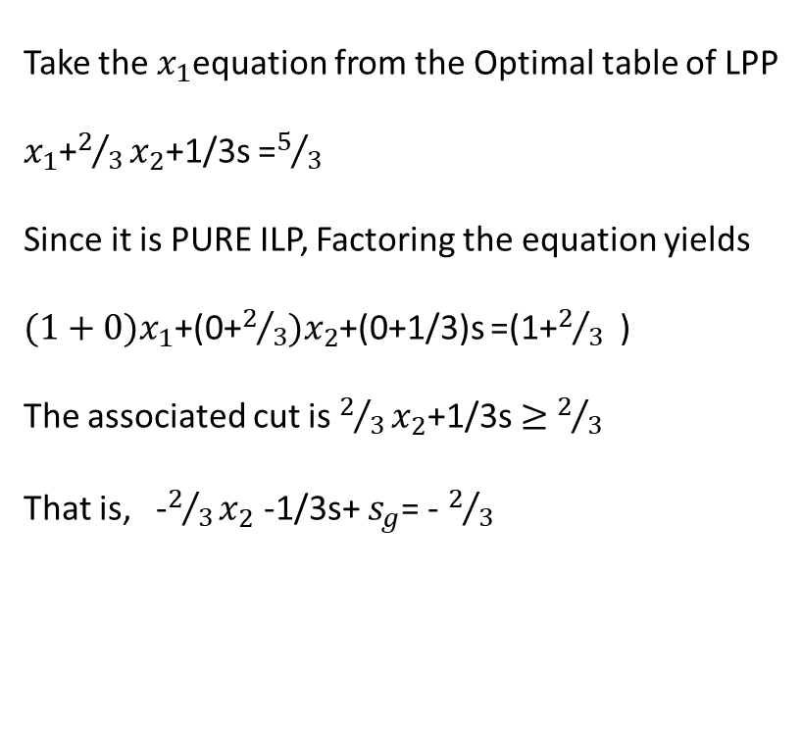

Step 2:
The Basic variable $x_{1}$is non-integer value
Step 3 :
Take the $x_{1}$equation from the Optimal table of LPP
$x_{1}$+$2/3x_{2}$+1/3s =$5/3$
Since it is PURE ILP, Factoring the equation yields
${(1+0)x}_{1}$+(0+$2/3)x_{2}$+(0+1/3)s =(1+$2/3$ )
The associated cut is $2/3x_{2}$+1/3s $≥$ $2/3$
That is, -$2/3x_{2}$ -1/3s+ $s_{g}$= - $2/3$

Slide 19
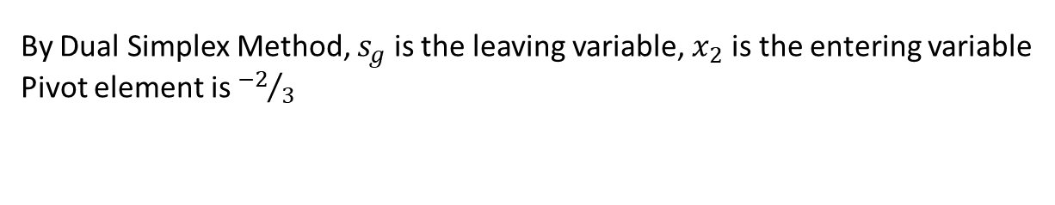
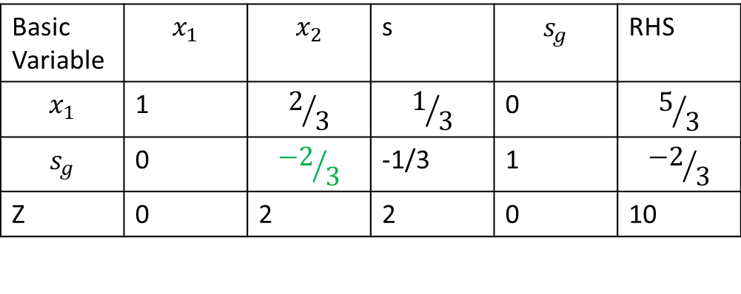
Step 4 and Step 5:
The above Gomorian constraint equation is added to the LP Optimal table as follows:
Basic Variable | $$x_{1}$$ | $$x_{2}$$ | s | $$s_{g}$$ | RHS
$$x_{1}$$ | 1 | $$2/3$$ | $$1/3$$ | 0 | $$5/3$$
$$s_{g}$$ | 0 | $${−2}/3$$ | -1/3 | 1 | $${−2}/3$$
Z | 0 | 2 | 2 | 0 | 10
The above table is Optimal but infeasible
By Dual Simplex Method, $s_{g}$ is the leaving variable, $x_{2}$ is the entering variable
Pivot element is ${−2}/3$

Slide 20
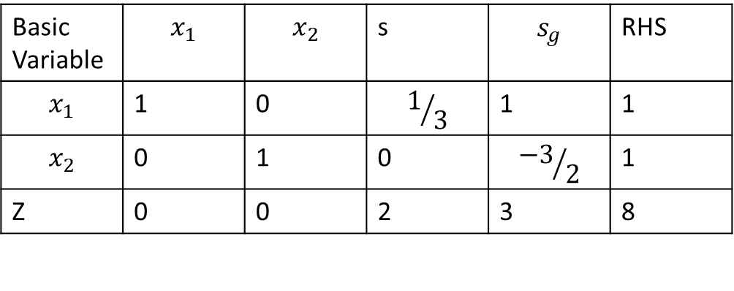
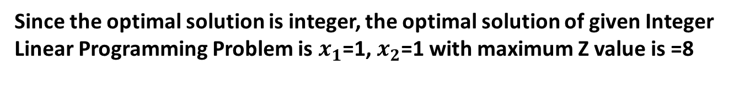
Step 6 :
Basic Variable | $$x_{1}$$ | $$x_{2}$$ | s | $$s_{g}$$ | RHS
$$x_{1}$$ | 1 | 0 | $$1/3$$ | 1 | 1
$$x_{2}$$ | 0 | 1 | 0 | $${−3}/2$$ | 1
Z | 0 | 0 | 2 | 3 | 8
This table is Optimal and the Optimal Solution of LPP is $x_{1}$=1, $x_{2}$=1
Since the optimal solution is integer, the optimal solution of given Integer
Linear Programming Problem is $x_{1}$=1, $x_{2}$=1 with maximum Z value is =8

Slide 21
Example 2 (Cutting Plane Method):
Consider the following pure ILP problem
Maximize Z=7x₁+10x₂
Subject to
- x₁ + 3x₂ ≤6
7x₁ + x₂ ≤35
x₁,x₂ ≥ 0 and integers

Slide 22
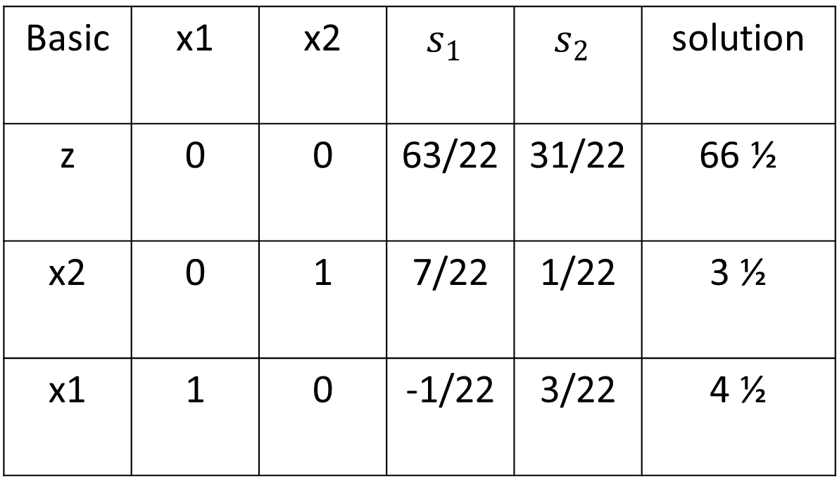
Given the slacks $s_{1}$ and $s_{2}$ , the optimum tableau is given as
Basic | x1 | x2 | $$s_{1}$$ | $$s_{2}$$ | solution
z | 0 | 0 | 63/22 | 31/22 | 66 ½
x2 | 0 | 1 | 7/22 | 1/22 | 3 ½
x1 | 1 | 0 | -1/22 | 3/22 | 4 ½

Slide 23
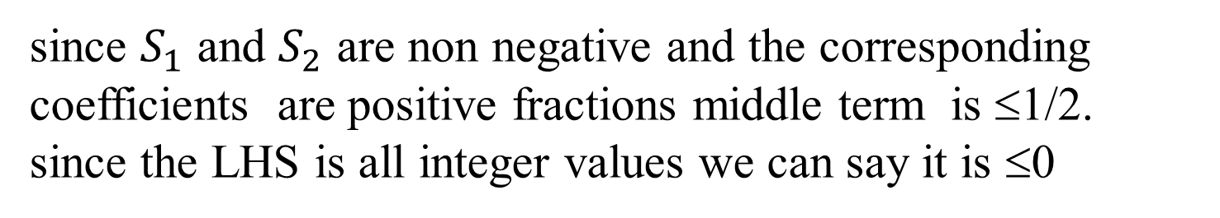
Factoring the $x_{2}$ row (arbitrarily selected )
since $S_{1}$ and $S_{2}$ are non negative and the corresponding coefficients are positive fractions middle term is ≤1/2.
since the LHS is all integer values we can say it is ≤0

Slide 24
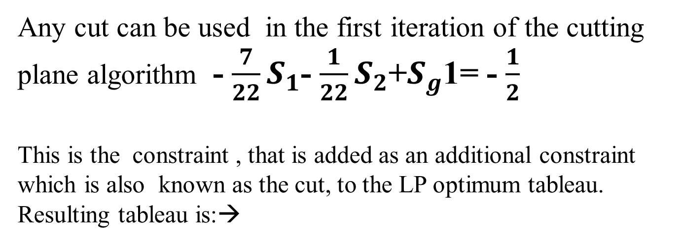
Any cut can be used in the first iteration of the cutting plane algorithm - $\frac{7}{22}S_{1}$- $\frac{1}{22}S_{2}$+$S_{g}$1= - $\frac{1}{2}$
This is the constraint , that is added as an additional constraint which is also known as the cut, to the LP optimum tableau.
Resulting tableau is:→

Slide 25
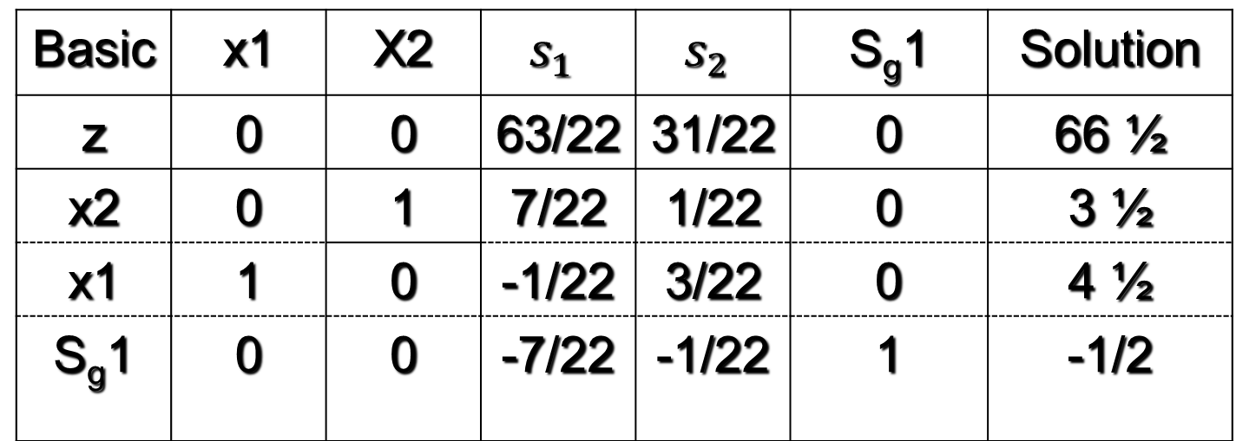
We get the following optimal ,but infeasible tableau.
Basic | x1 | X2 | $$s_{1}$$ | $$s_{2}$$ | S_{g}1 | Solution
z | 0 | 0 | 63/22 | 31/22 | 0 | 66 ½
x2 | 0 | 1 | 7/22 | 1/22 | 0 | 3 ½
x1 | 1 | 0 | -1/22 | 3/22 | 0 | 4 ½
S_{g}1 | 0 | 0 | -7/22 | -1/22 | 1 | -1/2
Ratio -9 -31
Smallest absolute value

Slide 26
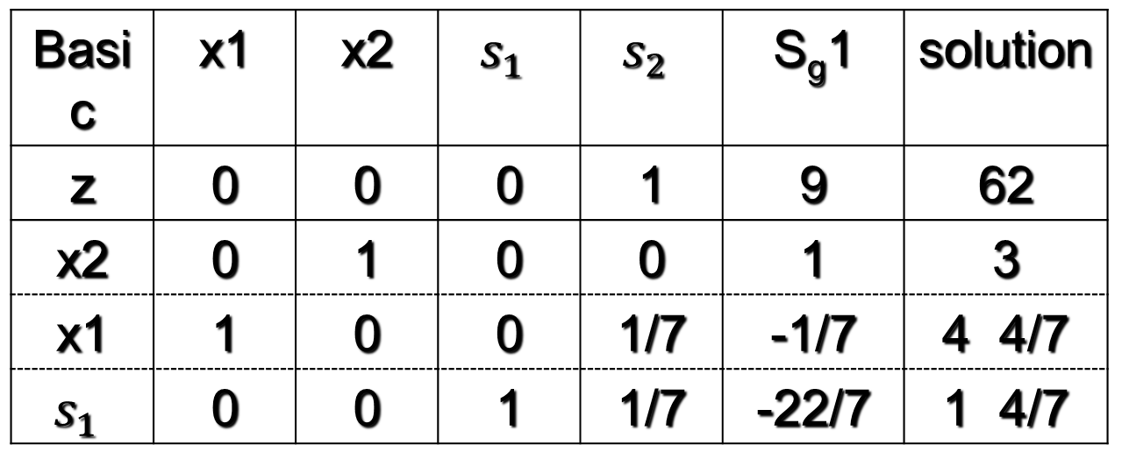
Applying the dual simplex method to recover feasibility, yields,
Basic | x1 | x2 | $$s_{1}$$ | $$s_{2}$$ | S_{g}1 | solution
z | 0 | 0 | 0 | 1 | 9 | 62
x2 | 0 | 1 | 0 | 0 | 1 | 3
x1 | 1 | 0 | 0 | 1/7 | -1/7 | 4 4/7
$$s_{1}$$ | 0 | 0 | 1 | 1/7 | -22/7 | 1 4/7
This solution is still non integer in x1 and s1.selecting x1
arbitrarily as the next source row the associated cut is →

Slide 27
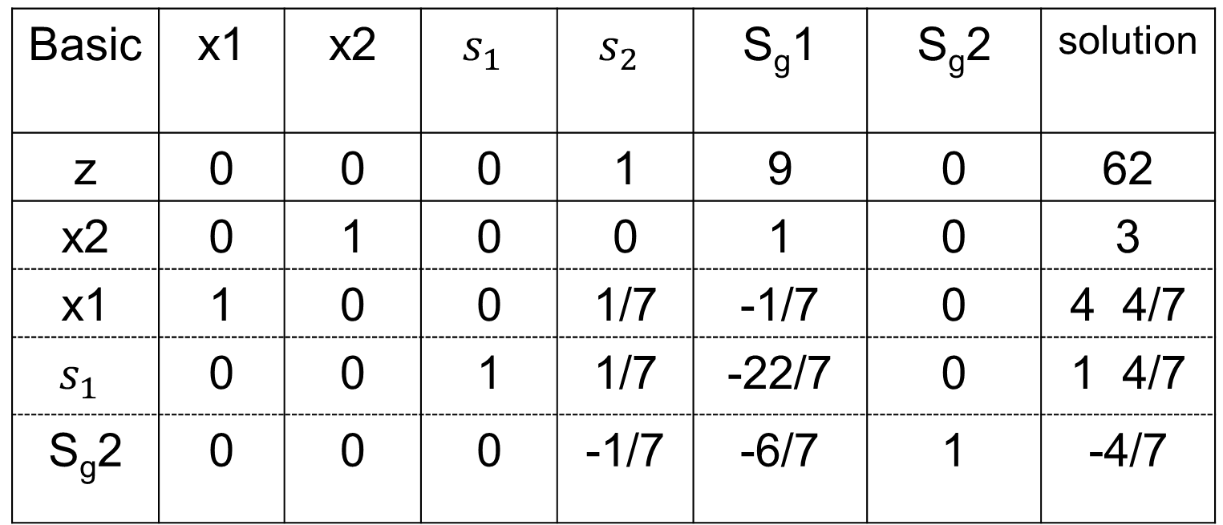
Basic | x1 | x2 | $$s_{1}$$ | $$s_{2}$$ | S_{g}1 | S_{g}2 | solution
z | 0 | 0 | 0 | 1 | 9 | 0 | 62
x2 | 0 | 1 | 0 | 0 | 1 | 0 | 3
x1 | 1 | 0 | 0 | 1/7 | -1/7 | 0 | 4 4/7
$$s_{1}$$ | 0 | 0 | 1 | 1/7 | -22/7 | 0 | 1 4/7
S_{g}2 | 0 | 0 | 0 | -1/7 | -6/7 | 1 | -4/7
Ratio -7 -31/2
Smallest absolute value

Slide 28
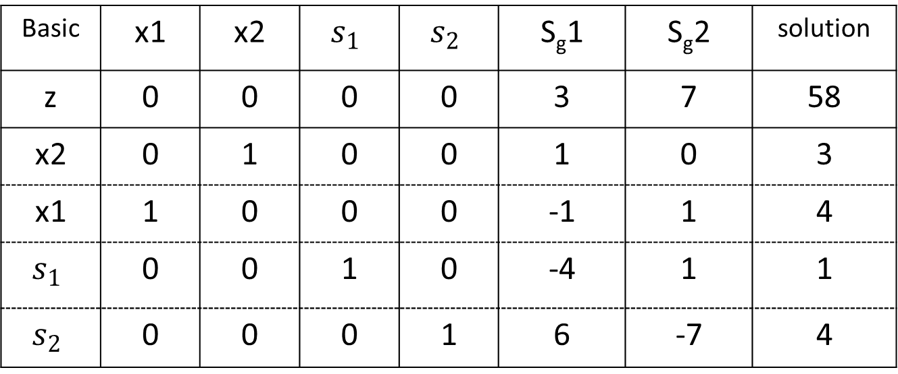
The dual simplex method yields the following tableau which is optimal, feasible and integer.
Basic | x1 | x2 | $$s_{1}$$ | $$s_{2}$$ | S_{g}1 | S_{g}2 | solution
z | 0 | 0 | 0 | 0 | 3 | 7 | 58
x2 | 0 | 1 | 0 | 0 | 1 | 0 | 3
x1 | 1 | 0 | 0 | 0 | -1 | 1 | 4
$$s_{1}$$ | 0 | 0 | 1 | 0 | -4 | 1 | 1
$$s_{2}$$ | 0 | 0 | 0 | 1 | 6 | -7 | 4
The Optimal solution of the given ILP is $x_{1}$=4, $x_{2}$= 3 with maximum Z=58

Slide 29
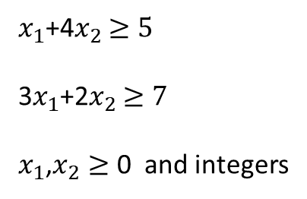

Example 3: (Cutting Plane Method)
Minimize Z =4$x_{1}$+5$x_{2}$
Subject to
$x_{1}$+4$x_{2}$ $≥5$
3$x_{1}$+2$x_{2}$ $≥7$
$x_{1}$,$x_{2}≥$ 0 and integers

Slide 30
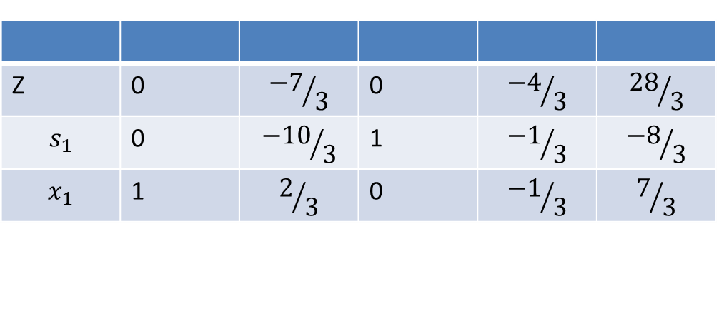
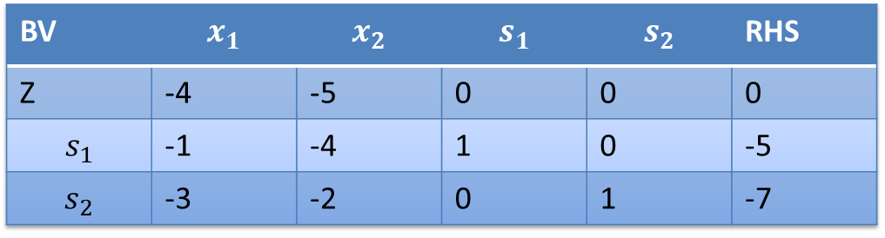
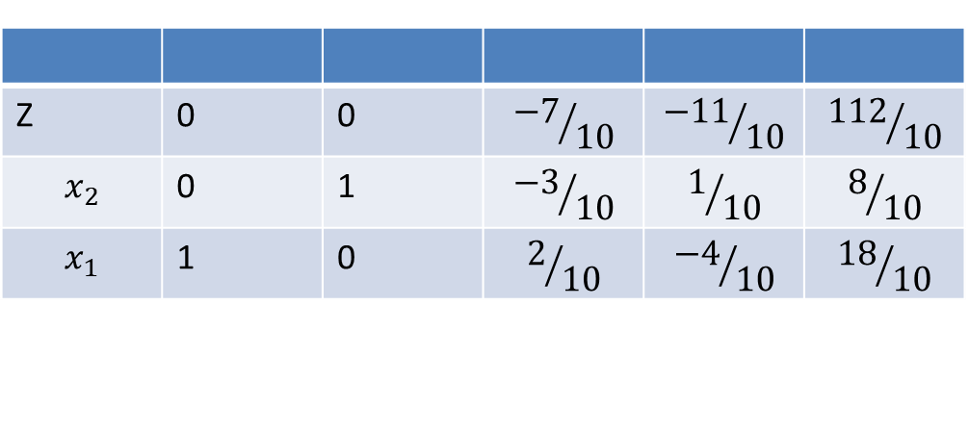
Ignoring the Integer restrictions, Solve the LPP by Dual Simplex Method
BV | $$x_{1}$$ | $$x_{2}$$ | $$s_{1}$$ | $$s_{2}$$ | RHS
Z | -4 | -5 | 0 | 0 | 0
$$s_{1}$$ | -1 | -4 | 1 | 0 | -5
$$s_{2}$$ | -3 | -2 | 0 | 1 | -7
Z | 0 | $${−7}/3$$ | 0 | $${−4}/3$$ | $${28}/3$$
$$s_{1}$$ | 0 | $${−10}/3$$ | 1 | $${−1}/3$$ | $${−8}/3$$
$$x_{1}$$ | 1 | $$2/3$$ | 0 | $${−1}/3$$ | $$7/3$$
Z | 0 | 0 | $${−7}/{10}$$ | $${−11}/{10}$$ | $${112}/{10}$$
$$x_{2}$$ | 0 | 1 | $${−3}/{10}$$ | $$1/{10}$$ | $$8/{10}$$
$$x_{1}$$ | 1 | 0 | $$2/{10}$$ | $${−4}/{10}$$ | $${18}/{10}$$
The above table is the Optimal Simplex table of LPP

Slide 31
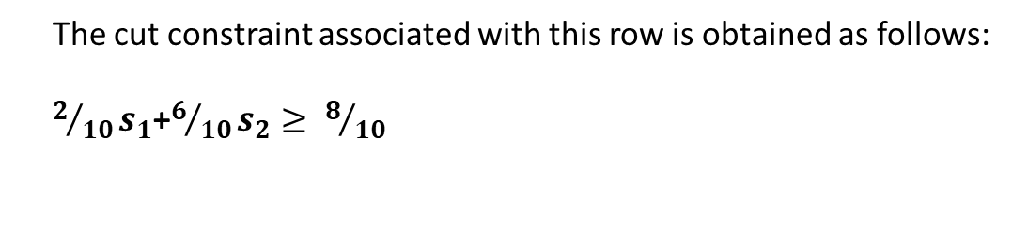

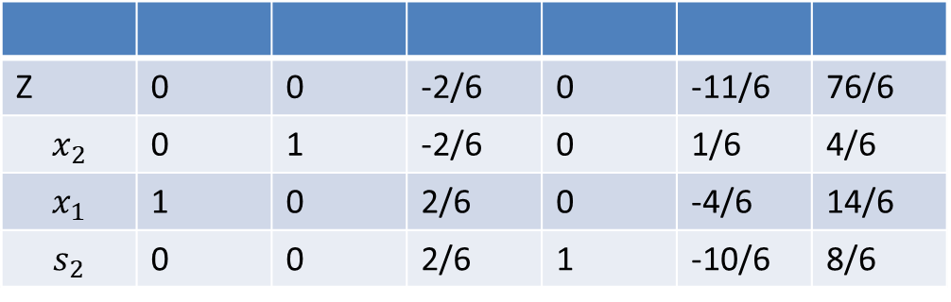
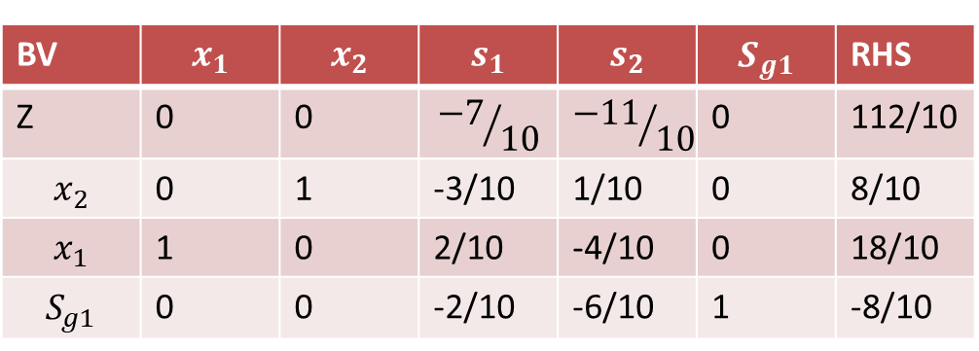
Select $x_{1}$as the source row for generating the cut
The cut constraint associated with this row is obtained as follows:
$2/{10}s_{1}$+$6/{10}s_{2}≥ 8/{10}$
The Optimal Simplex table of LPP is Updated as follows:
BV | $$x_{1}$$ | $$x_{2}$$ | $$s_{1}$$ | $$s_{2}$$ | $$S_{g1}$$ | RHS
Z | 0 | 0 | $${−7}/{10}$$ | $${−11}/{10}$$ | 0 | 112/10
$$x_{2}$$ | 0 | 1 | -3/10 | 1/10 | 0 | 8/10
$$x_{1}$$ | 1 | 0 | 2/10 | -4/10 | 0 | 18/10
$$S_{g1}$$ | 0 | 0 | -2/10 | -6/10 | 1 | -8/10
Z | 0 | 0 | -2/6 | 0 | -11/6 | 76/6
$$x_{2}$$ | 0 | 1 | -2/6 | 0 | 1/6 | 4/6
$$x_{1}$$ | 1 | 0 | 2/6 | 0 | -4/6 | 14/6
$$s_{2}$$ | 0 | 0 | 2/6 | 1 | -10/6 | 8/6

Slide 32
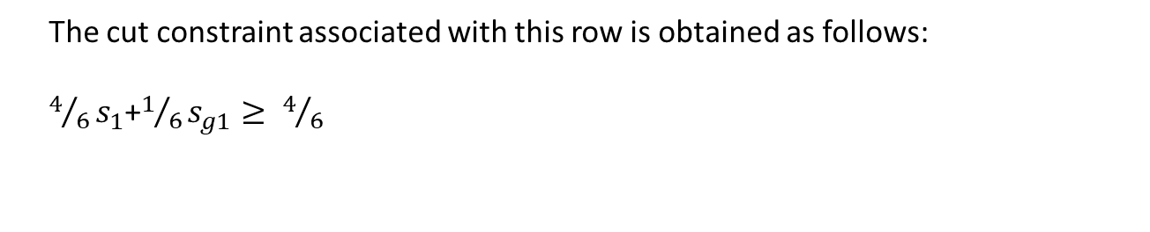
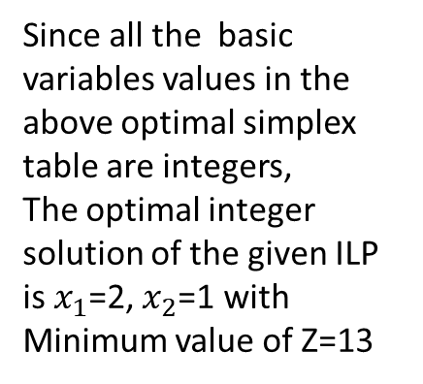
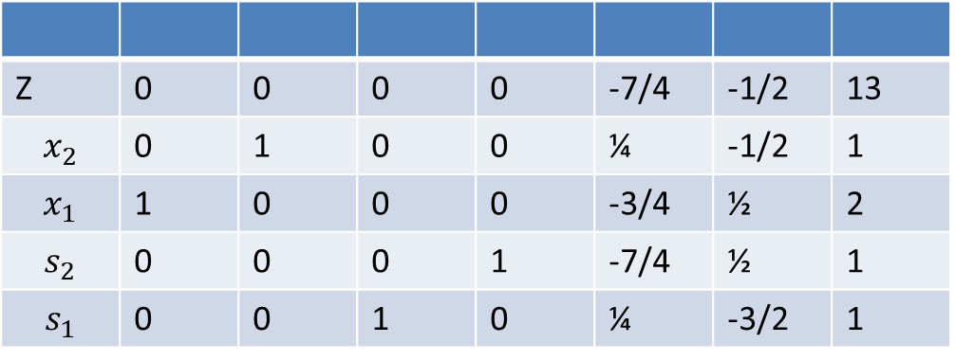
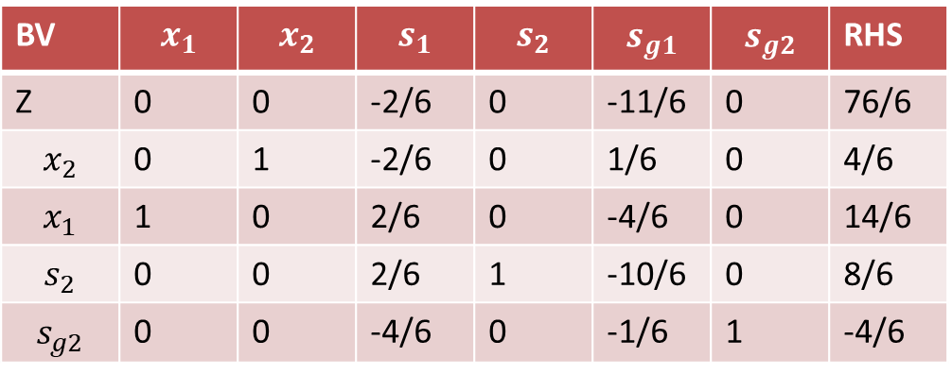
Select $x_{2}$ row as the source row for generating the cut
The cut constraint associated with this row is obtained as follows:
$4/6s_{1}$+$1/6s_{g1}≥ 4/6$
BV | $$x_{1}$$ | $$x_{2}$$ | $$s_{1}$$ | $$s_{2}$$ | $$s_{g1}$$ | $$s_{g2}$$ | RHS
Z | 0 | 0 | -2/6 | 0 | -11/6 | 0 | 76/6
$$x_{2}$$ | 0 | 1 | -2/6 | 0 | 1/6 | 0 | 4/6
$$x_{1}$$ | 1 | 0 | 2/6 | 0 | -4/6 | 0 | 14/6
$$s_{2}$$ | 0 | 0 | 2/6 | 1 | -10/6 | 0 | 8/6
$$s_{g2}$$ | 0 | 0 | -4/6 | 0 | -1/6 | 1 | -4/6
Z | 0 | 0 | 0 | 0 | -7/4 | -1/2 | 13
$$x_{2}$$ | 0 | 1 | 0 | 0 | ¼ | -1/2 | 1
$$x_{1}$$ | 1 | 0 | 0 | 0 | -3/4 | ½ | 2
$$s_{2}$$ | 0 | 0 | 0 | 1 | -7/4 | ½ | 1
$$s_{1}$$ | 0 | 0 | 1 | 0 | ¼ | -3/2 | 1
Since all the basic variables values in the above optimal simplex table are integers,
The optimal integer solution of the given ILP is $x_{1}$=2, $x_{2}$=1 with Minimum value of Z=13

Slide 33
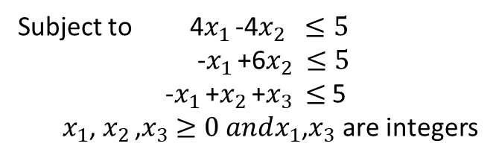

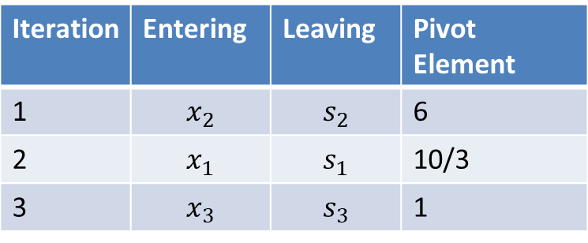
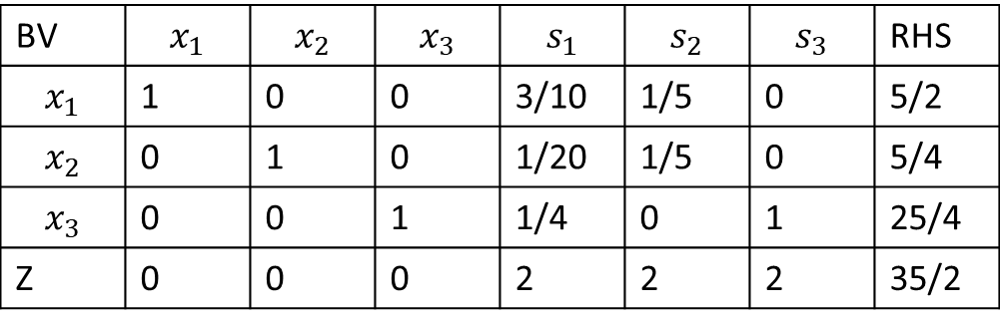
Example 4 :(Cutting Plane Method for Mixed ILP)
Iteration | Entering | Leaving | Pivot Element
1 | $$x_{2}$$ | $$s_{2}$$ | 6
2 | $$x_{1}$$ | $$s_{1}$$ | 10/3
3 | $$x_{3}$$ | $$s_{3}$$ | 1
Maximize Z=4$x_{1 }$+6$x_{2 }$+2$x_{3}$
Subject to 4$x_{1 }$-4$x_{2 } ≤5$
-$x_{1 }$+6$x_{2 }≤5$
-$x_{1 }$+$x_{2 }$+$x_{3}$ $≤$ 5
$x_{1}$, $x_{2 }$,$x_{3}$ $≥0 andx_{1}$,$x_{3}$ are integers
Ignoring the integer condition, solve the LPP using Simplex method,
the Optimal solution of the LPP is obtained in the Fourth Iteration
The following is the Optimal simplex table of LPP
BV | $$x_{1}$$ | $$x_{2}$$ | $$x_{3}$$ | $$s_{1}$$ | $$s_{2}$$ | $$s_{3}$$ | RHS
$$x_{1}$$ | 1 | 0 | 0 | 3/10 | 1/5 | 0 | 5/2
$$x_{2}$$ | 0 | 1 | 0 | 1/20 | 1/5 | 0 | 5/4
$$x_{3}$$ | 0 | 0 | 1 | 1/4 | 0 | 1 | 25/4
Z | 0 | 0 | 0 | 2 | 2 | 2 | 35/2

Slide 34
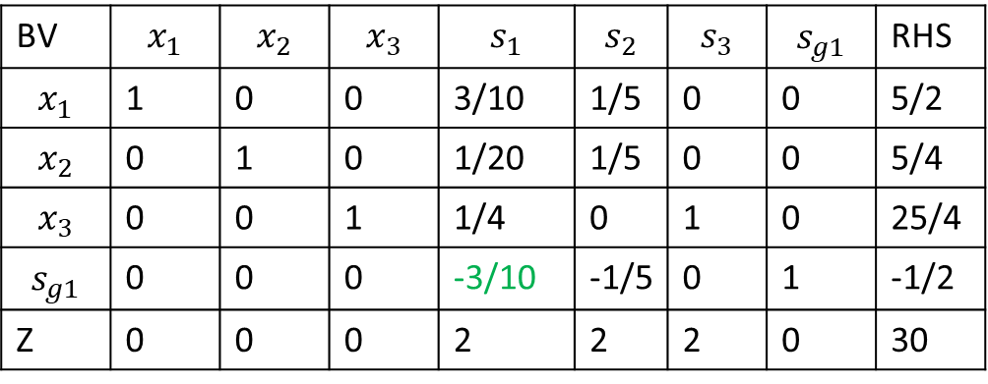
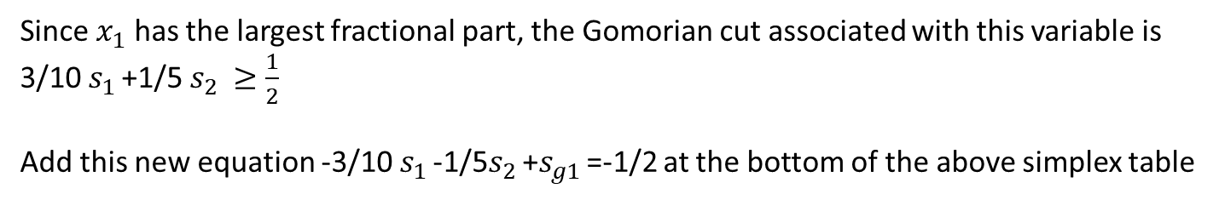
Since $x_{1}$ has the largest fractional part, the Gomorian cut associated with this variable is
3/10 $s_{1 }$+1/5 $s_{2 }≥\frac{1}{2}$
Add this new equation -3/10 $s_{1 }$-1/5$s_{2 }$+$s_{g1 }$=-1/2 at the bottom of the above simplex table
BV | $$x_{1}$$ | $$x_{2}$$ | $$x_{3}$$ | $$s_{1}$$ | $$s_{2}$$ | $$s_{3}$$ | $$s_{g1}$$ | RHS
$$x_{1}$$ | 1 | 0 | 0 | 3/10 | 1/5 | 0 | 0 | 5/2
$$x_{2}$$ | 0 | 1 | 0 | 1/20 | 1/5 | 0 | 0 | 5/4
$$x_{3}$$ | 0 | 0 | 1 | 1/4 | 0 | 1 | 0 | 25/4
$$s_{g1}$$ | 0 | 0 | 0 | -3/10 | -1/5 | 0 | 1 | -1/2
Z | 0 | 0 | 0 | 2 | 2 | 2 | 0 | 30
The above table is Optimal but infeasible
Use Dual Simple Method to recover feasibility

Slide 35
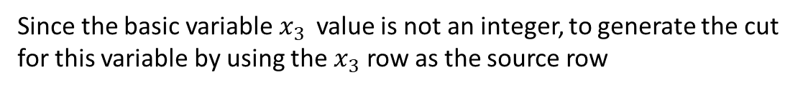
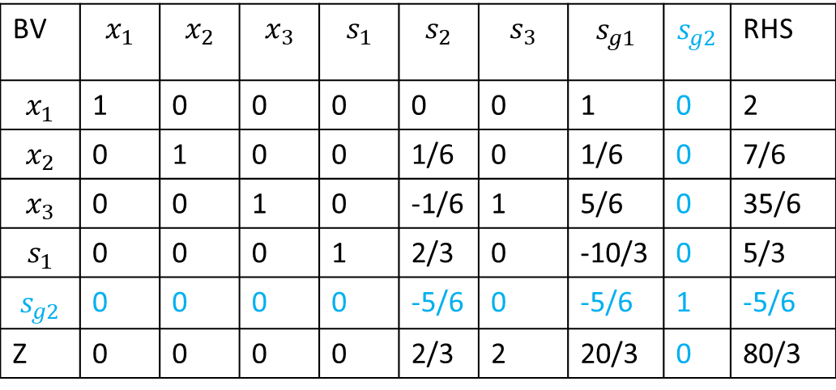
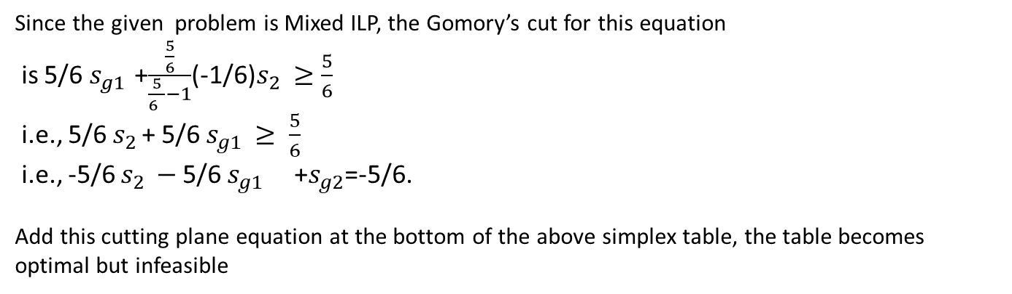

BV | $$x_{1}$$ | $$x_{2}$$ | $$x_{3}$$ | $$s_{1}$$ | $$s_{2}$$ | $$s_{3}$$ | $$s_{g1}$$ | $$s_{g2}$$ | RHS
$$x_{1}$$ | 1 | 0 | 0 | 0 | 0 | 0 | 1 | 0 | 2
$$x_{2}$$ | 0 | 1 | 0 | 0 | 1/6 | 0 | 1/6 | 0 | 7/6
$$x_{3}$$ | 0 | 0 | 1 | 0 | -1/6 | 1 | 5/6 | 0 | 35/6
$$s_{1}$$ | 0 | 0 | 0 | 1 | 2/3 | 0 | -10/3 | 0 | 5/3
$$s_{g2}$$ | 0 | 0 | 0 | 0 | -5/6 | 0 | -5/6 | 1 | -5/6
Z | 0 | 0 | 0 | 0 | 2/3 | 2 | 20/3 | 0 | 80/3
Since the basic variable $x_{3 }$ value is not an integer, to generate the cut
for this variable by using the $x_{3}$ row as the source row
-1/6$s_{2 }$+$s_{3 }$+5/6$s_{g1 }$= 35/6
Since the given problem is Mixed ILP, the Gomory’s cut for this equation
is 5/6 $s_{g1 }$+$\frac{\frac{5}{6}}{\frac{5}{6 }−1}$(-1/6)$s_{2 }≥\frac{5}{6}$
i.e., 5/6 $s_{2 }$+ 5/6 $s_{g1 }≥ \frac{5}{6}$
i.e., -5/6 $s_{2 }−$ 5/6 $s_{g1 }$+$s_{g2}$=-5/6.
Add this cutting plane equation at the bottom of the above simplex table, the table becomes optimal but infeasible

Slide 36
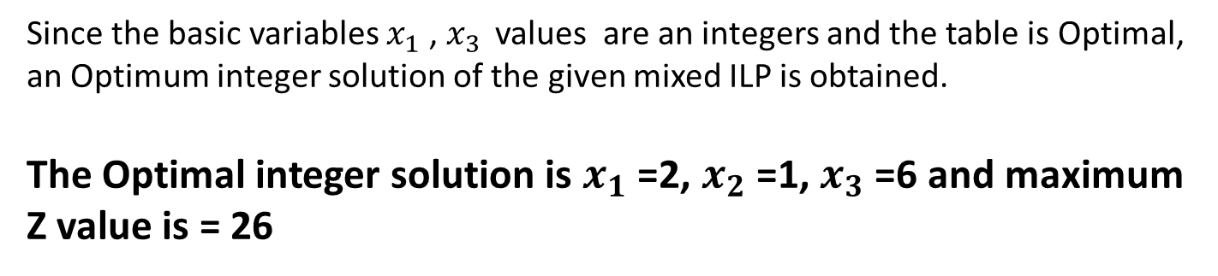
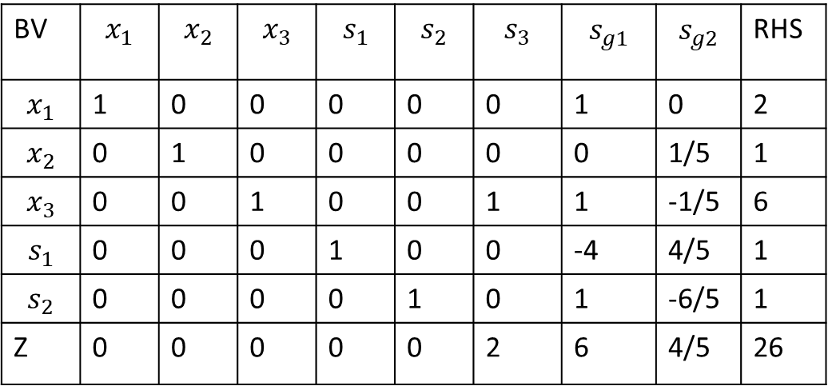
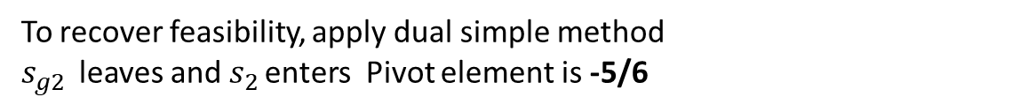
To recover feasibility, apply dual simple method
$s_{g2 }$ leaves and $s_{2 }$enters Pivot element is -5/6
BV | $$x_{1}$$ | $$x_{2}$$ | $$x_{3}$$ | $$s_{1}$$ | $$s_{2}$$ | $$s_{3}$$ | $$s_{g1}$$ | $$s_{g2}$$ | RHS
$$x_{1}$$ | 1 | 0 | 0 | 0 | 0 | 0 | 1 | 0 | 2
$$x_{2}$$ | 0 | 1 | 0 | 0 | 0 | 0 | 0 | 1/5 | 1
$$x_{3}$$ | 0 | 0 | 1 | 0 | 0 | 1 | 1 | -1/5 | 6
$$s_{1}$$ | 0 | 0 | 0 | 1 | 0 | 0 | -4 | 4/5 | 1
$$s_{2}$$ | 0 | 0 | 0 | 0 | 1 | 0 | 1 | -6/5 | 1
Z | 0 | 0 | 0 | 0 | 0 | 2 | 6 | 4/5 | 26
Since the basic variables $x_{1}$ , $x_{3 }$ values are an integers and the table is Optimal, an Optimum integer solution of the given mixed ILP is obtained.
The Optimal integer solution is $x_{1}$ =2, $x_{2}$ =1, $x_{3}$ =6 and maximum Z value is = 26

Slide 37
Properties of Gomory’s Method
1. Additional linear constraints never cut off that portion of the original feasible solution space which contains a feasible integer solution to the original problem.
2. Each new additional constraints cuts off the current non integer optimal solution to the linear programming problem.

Slide 38
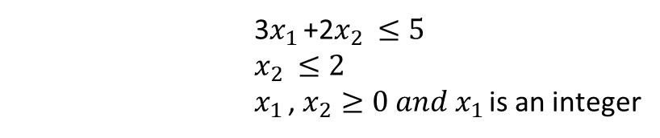
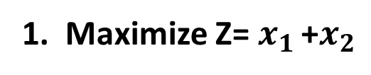
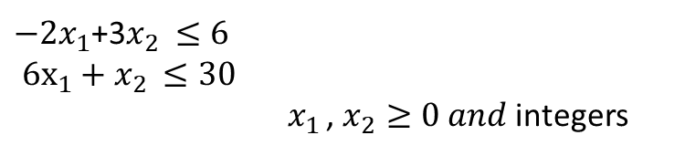
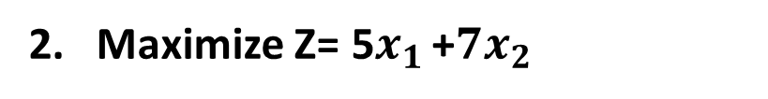
Solve the following problems
1. Maximize Z= $x_{1 }$+$x_{2}$
Subject to
3$x_{1 }$+2$x_{2 }≤5$
$x_{2 }≤2$
$x_{1 }$, $x_{2}≥0 and x_{1 }$is an integer
2. Maximize Z= 5$x_{1 }$+${7x}_{2}$
Subject to
$−2x_{1}$+3$x_{2 }≤6$
$6x_{1}+x_{2 }≤30$
$x_{1 }$, $x_{2}≥0 and$integers

Slide 39

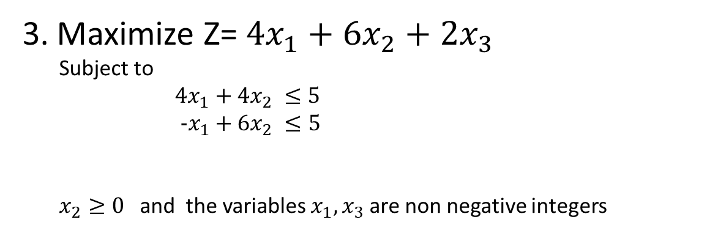
Maximize Z= $4x_{1}+6x_{2}+2x_{3}$
Subject to
$4x_{1}+4x_{2} ≤5$
$-x_{1}+6x_{2} ≤5$
$x_{2}≥0$ and the variables $x_{1}, x_{3}$are non negative integers
$$-x_{1}+x_{2}+x_{3} ≤5$$

